Slide 1
Design Patterns
Presented By:
Fernando Zamora
Twitter: @fernandozamoraj
Blog: fernandozamorajimenez.blogspot.com
Github: https://github.com/fernandozamoraj

Slide 2
About Me
Fernando Zamora
Developer
Aspiring Craftsman
Work: Technical Lead MAT, Government Contract Winforms C#
Hobbies: Write code outside of work that I don’t get to write at work
Games: XNA, Windows Phone, Android
Web: HTML5, PHP, Asp.net, Javascript

Slide 3
Philosophy and Beginnings
We are talking about software. Right?
Reusable solution to a commonly occurring problem within a given context
Christopher Alexander (1977/79)
A Pattern Language: Towns, Buildings, Construction
4. Form a common language
5. GoF – DESIGN PATTERNS Elements of Reusable Object Oriented Software Gamma, et al. (1995)

Slide 4
Design Pattern Categories
23 Patterns in GoF- Foundation
3 Groups
Creational
Structural
Behavioral
Specific Areas such as architecture, UI, concurrency, security
4. Forces and Solution
5. UML

Slide 5
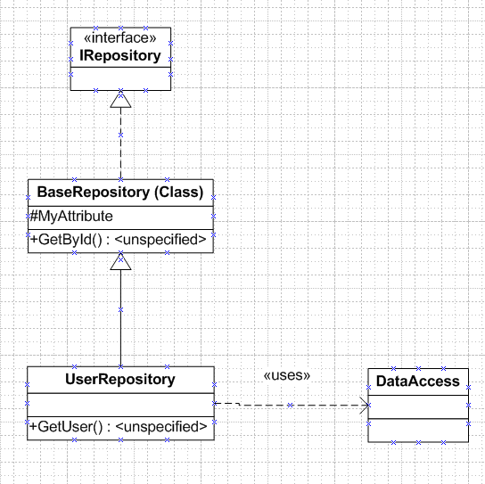
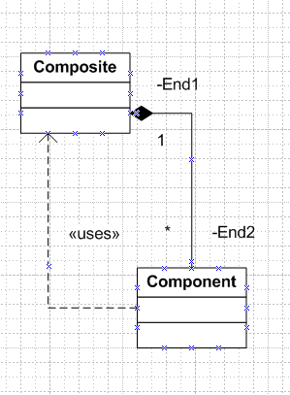
UML Symbols
.

Slide 6
Structural Patterns
Decorator – Add or remove functionality at run time
Proxy – Control Access to an Object
Bridge – Enable development of the interface and implementation of a component to proceed independently. Switch runtime implementations.
Composite – Treat single objects and composites in same way
Flyweight – Reduce cost of working with large number of very small objects
Adapter – Match otherwise incompatible interfaces
Facade – Reorganize a system with many subsystems into identifiable layers of single entry points
Simplify Interface to a complex subsystem

Slide 7
Creational Patterns
Prototype – Creates new objects by cloning of a few stored prototypes
Factory Method – Method decides which concrete implementation
Singleton – One instance of a class with global access

Slide 8
Behavioral Patterns
Strategy – Client chooses concrete implementation
State – Context changes from state to state
Template Method – Template algorithm with certain steps to be handled elsewhere
Chain of Responsibility – List of handler objects and handling stops at first successful handling
Iterator – foreach case closed
Mediator – enables communications of objects without those objects knowing each other

Slide 9
Behavioral Patterns
Observer – Publisher Subscriber System
Visitor – Defines and performs new operations on all elements of an existing structure
Interpreter – ?
Memento – Captures the state of an object’s internal state and saves externally

Slide 10
Behavioral Patterns
Strategy – Creates new objects by cloning of a few stored prototypes
State – Method decides which concrete implementation
Template Method – One instance of a class with global access
Chain of Responsibility – Creates new objects by cloning of a few stored prototypes
Iterator – Method decides which concrete implementation
Mediator – One instance of a class with global access

Slide 11
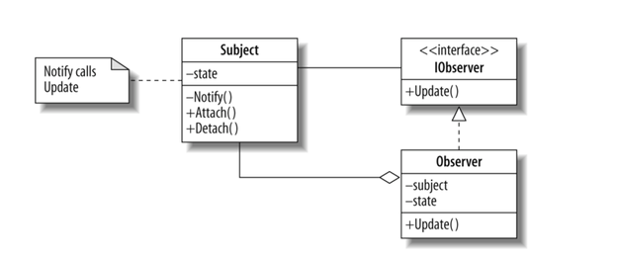
Observer Pattern
Publisher/Subscriber

Slide 12
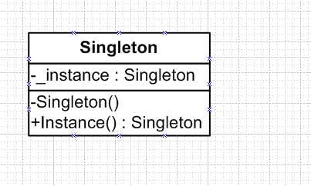
Singleton Pattern
Single Instance across the application

Slide 13
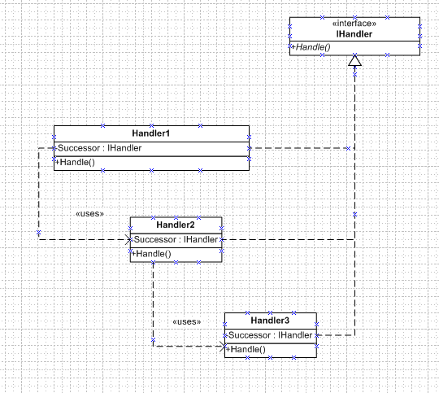
Chain of Responsibility
.

Slide 14
Factory Method
.

Slide 15
About Fernando Zamora
Sr. Software Engineer @ McLane Advanced Technologies
Personal Blog, Etc: http://fernandozamorajimenez.blogspot.com/
Email: fernando.zamora.jimenez@gmail.com
Twitter: @fernandozamoraj
Copyright 2008 McLane Advanced Technologies, LLC

